Slide 1
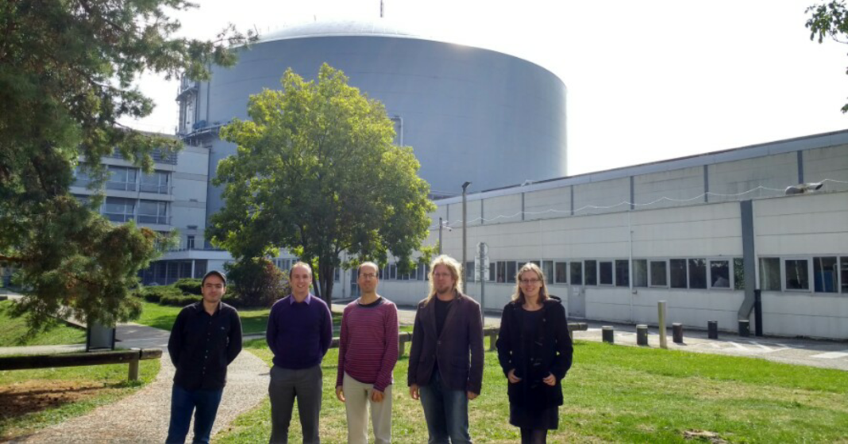

Mantid at the ILL
Mantid ILL Team: G. Vardanyan, I. Bush, M. Gonzalez, A. Soininen, V. Reimund

Slide 2
Outline
Overview of Mantid at the ILL
Current status and future plans
Backscattering reduction (Gagik)
Time-of-flight spectroscopy (Antti)
Scanning instruments (Ian)
(Verena)

Slide 3
Mantid data reduction for ILL instruments
Initial ILL Mantid algorithms were available
( loaders, instrument definitions, workflow algorithms )
Data Reduction scripts written in Python
often consisting of several algorithms
One instrument responsible per technique
Weekly meetings
Team development
e.g. for Backscattering and Time-of-Flight instruments
Mantid training ( e.g. for Time-of-Flight instrument scientists )

Slide 4
First instruments
Technique | Instruments | Mantid release 2017 | ILL cycle 2017
Backscattering Spectroscopy | In16b | 3.9, Feb 13 | Jan 19 – March 8
Time-of-Flight Spectroscopy | In4, In5, In6 | 3.10, June 12 | Sept 1 – Oct 18
Development completed, minor changes and continuous verification

Slide 5
Current development
Technique | Instruments | Mantid release 2017 (partially) | ILL cycle 2017
Reflectometers | D17 Time-of-Flight / monochromatic*, polarised / un-polarised Figaro | 3.10, June 12 3.10, June 12 | Sept 1 – Oct 18 Nov 3 – Dec 21
Powder Diffractometers | D1B, D20, D2B*, D4C* | 3.10, June 12 3.11 | Sept 1 – Oct 18 Nov 3 – Dec 21
Instrument definitions and loaders completed, reduction workflows (Python) in progress
* Moving detectors

Slide 6
Future development
Technique | Instruments | Dates
Large-scale structure diffractometers | SANS D11, D22, D33 | End of 2017 – June 2018
Custom graphical user interfaces | Time-of-Flight Reflectometers … | End of Dec 2017
Liquid, polarized diffractometers, spectrometers and others | D4, D7, SALSA Lagrange, D16 | End of Dec 2018 May 2019

Slide 7
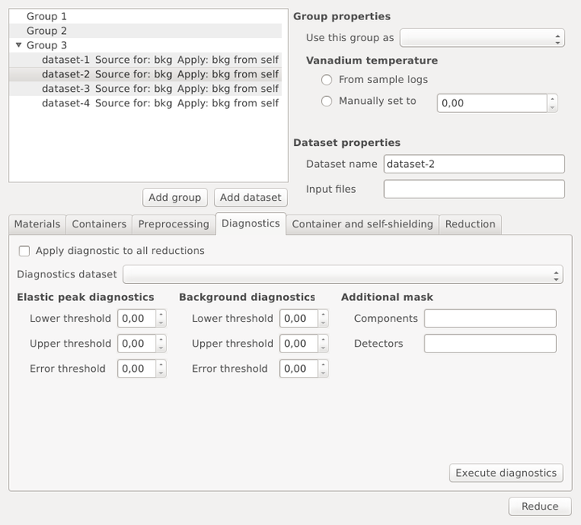
Future development
Example prototype GUI (PyQt)
Will be based on DataProcessor widget
Data Handling
Event mode data (March 2018)
Live data listeners
interaction with Nomad, May 2019)
Auto-reduction
Background, Vanadium, … measurement recognition
-> realised for many other facilities
Mantid 4.0 contributions

Slide 8
Backscattering
G. Vardanyan

Slide 9
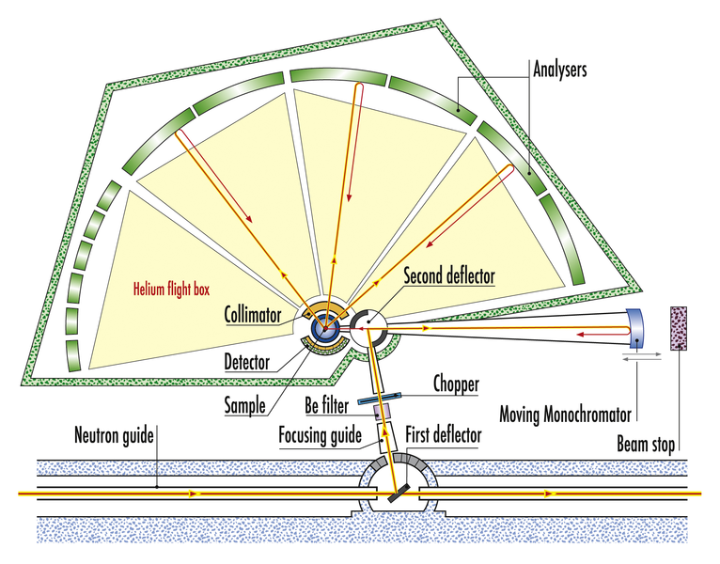
Backscattering – IN16B
Overview of the instrument
IN16B sub-microEV resolution backscattering spectrometer at ILL
Operates in several modes:
Quasi-elastic scattering (QENS); Doppler drive with sinusoidal profile
Fixed window scans (FWS):
Elastic; Doppler drive is stopped
Inelastic; Doppler moves at constant speed
Data can be recorded:
In mirror sense; when the data in doppler acceleration and deceleration phases are recorded separately

Slide 10
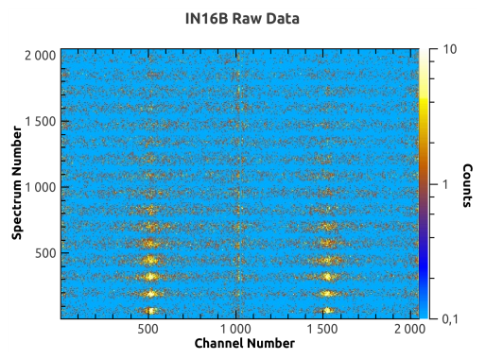
IN16B Reduction in Mantid
Data reduction is organized in three python workflow algorithms as follows
Starting point was initial work done by Spencer & Co.
Critical requirement was multiple file handling - O(1000) for FWS
Automatic handling of different data and reduction types
IndirectILLReductionQENS
IndirectILLEnergyTransfer
IndirectILLReductionFWS
To treat common steps
For single (or multiple summed) files

Slide 11
Common reduction
IndirectILLEnergyTransfer
Automatically deduces the reduction type
Crops into left and right wings, if in mirror mode
Groups the pixels in multi-detectors
Normalizes to monitor:
Bin-to-bin for QENS
Integral-based for FWS
Converts channel # to energy transfer
Converts spectrum axis to scattering angle or momentum transfer
Outputs one or two workspaces, dependent on mirror mode

Slide 12
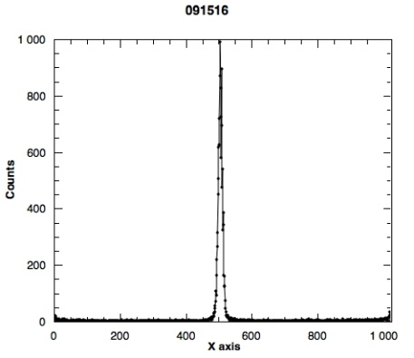
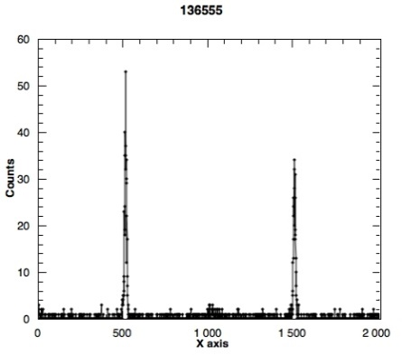
QENS reduction
IndirectILLReductionQENS
Raw Data
Empty container (background) subtraction:
Bin-to-bin, with scale factor
Detector efficiency correction (calibration):
Division by the integral of the peak in vanadium run
Adjustable peak range
Peak alignment (unmirroring):
Several options offered
Vanadium run can be used for reference peak positions
Uses simple Gaussian for peak finding through FindEPP algorithm

Slide 13
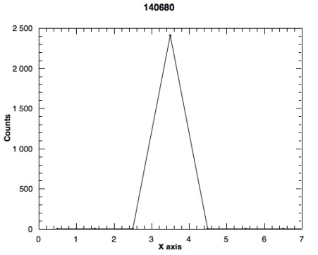
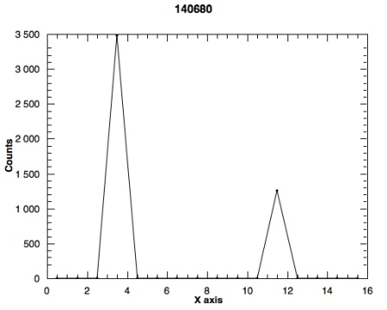
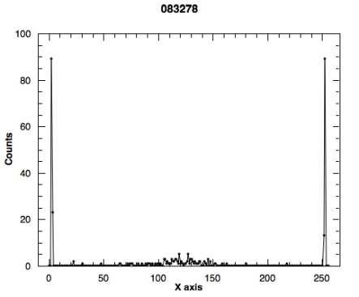
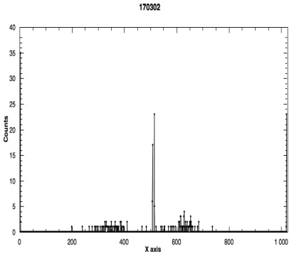
FWS reduction
IndirectILLReductionFWS
Raw Data
Integration of the signal, automatic range
Construction of intensity as a function of the metadata, e.g. temperature
Empty container (background) subtraction
Detector efficiency correction (calibration)
Option to average or interpolate both the background and the calibration as a function of temperature
Output for each distinct Doppler’s energy value, including 0 for elastic scan
Elastic
Inelastic

Slide 14
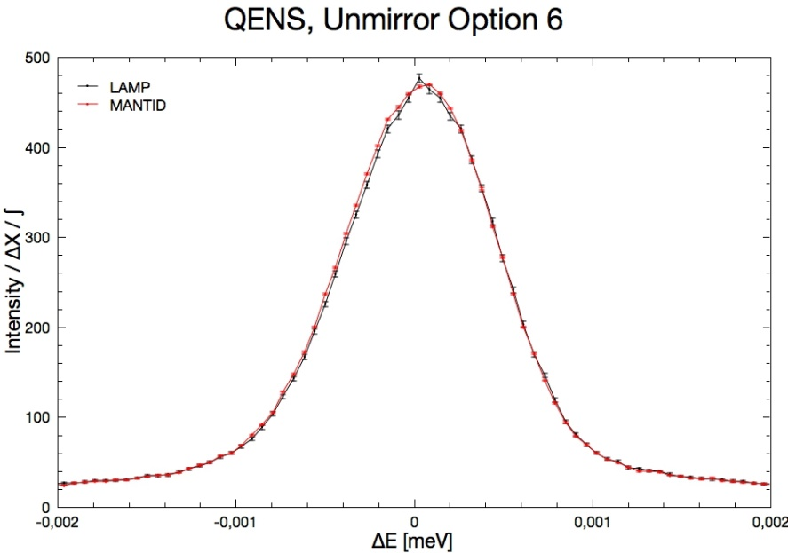
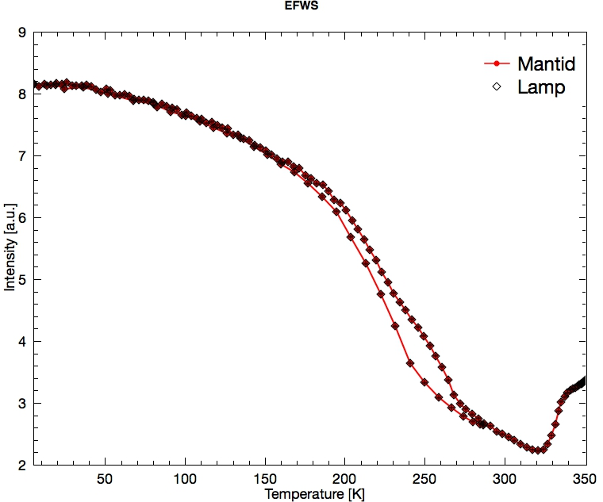
Benchmarking against LAMP
Compatible results in all modes

Slide 15
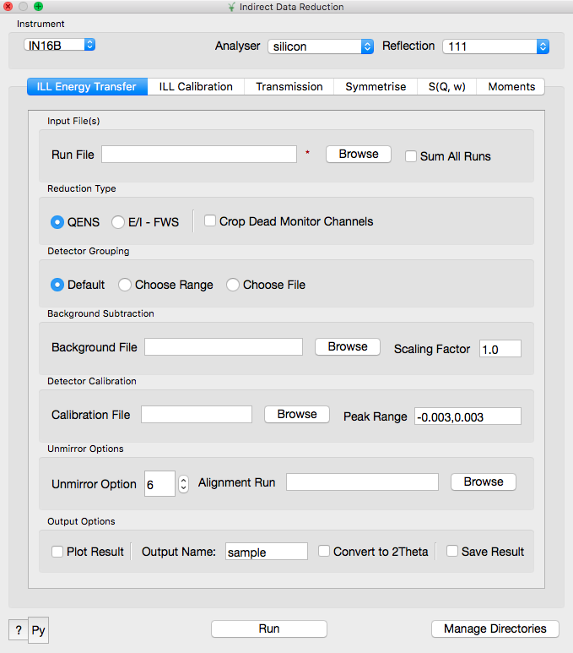
Indirect Reduction GUI
Custom interface (C++) in MantidPlot
Configures and runs the reduction algorithms

Slide 16
TOF Reduction
A. Soininen

Slide 17
TOF spectrometers at ILL
IN4, IN6
Traditional spectrometers with O(100) detectors
Similar instruments (in Mantid’s point of view)
IN5
Position sensitive detectors: O(10000) pixels
High memory and CPU requirements

Slide 18
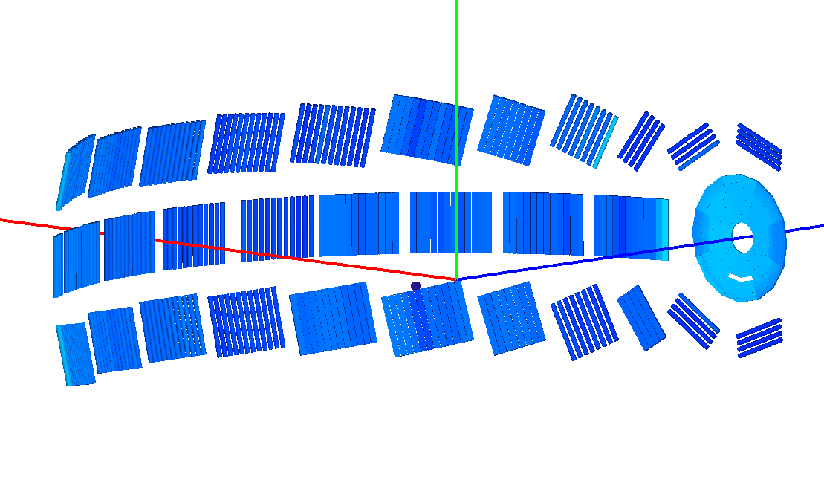
Instrument definitions
IN4 Instrument

Slide 19
Typical experiment
Vanadium, empty container(s), sample(s)
Different temperatures, wavelengths
Missing data points
Need for flexibility in reduction

Slide 20
Algorithms overview
CollectData: load files, simple reduction
Diagnose: find faulty detectors
IntegrateVanadium
(Apply)SelfShielding: absorption corrections
Reduction: calculate S(q,ω)
Reduction consists of independent workflow algorithms
Enables working with complex datasets

Slide 21
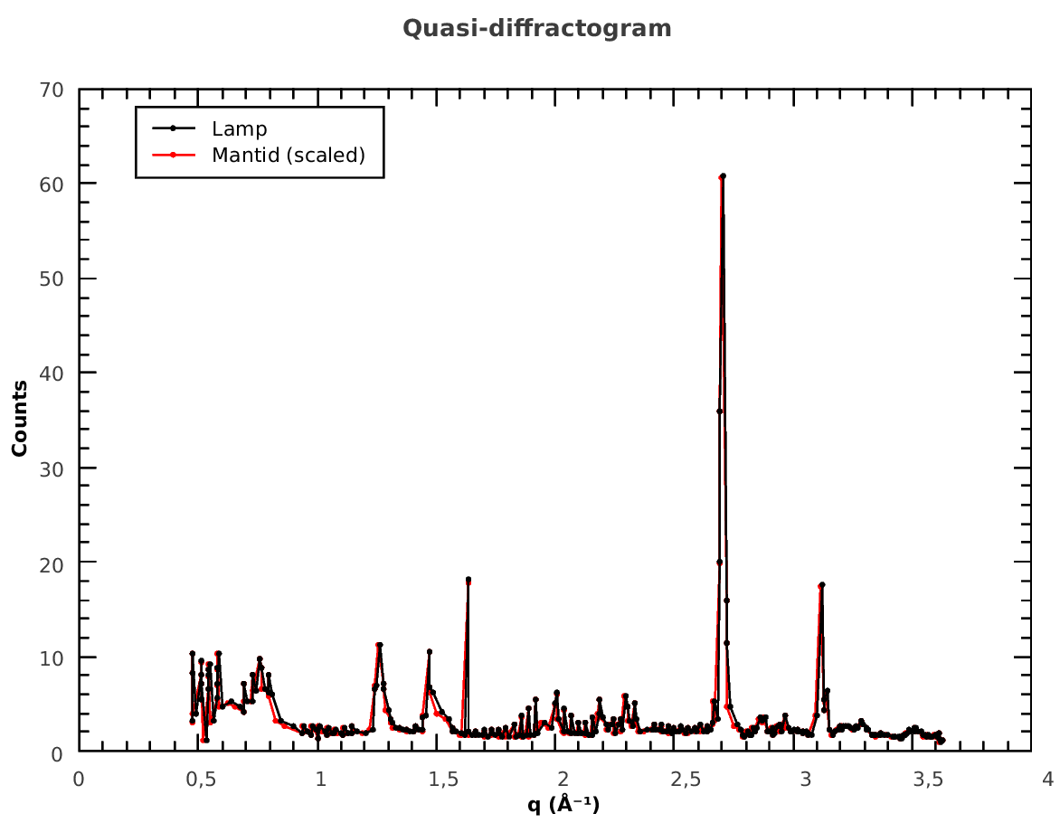
Comparison Mantid vs. LAMP
The legacy LAMP workflow well reproducible in Mantid
Differences show up in S(θ,ω) (next slide)

Slide 22
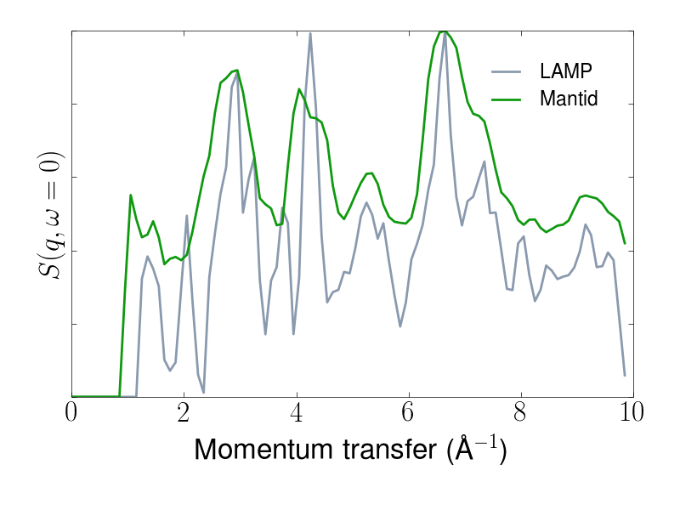
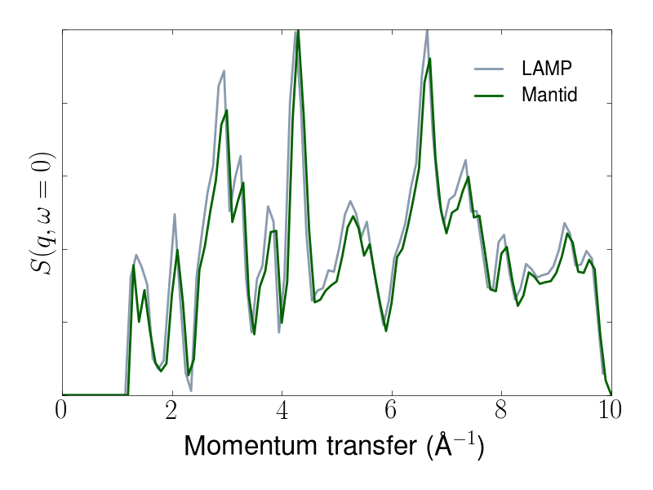
S(q,ω) Full geometry vs. point detectors

Slide 23
Examples of other ILL specific work
Incident energy calibration (IN4, IN6)
Arbitrary TOF delay
Support for varying sample-to-detector distances
Locale issues (number formatting)

Slide 24
Scanning Instruments
I. Bush

Slide 25
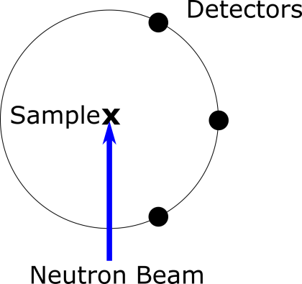
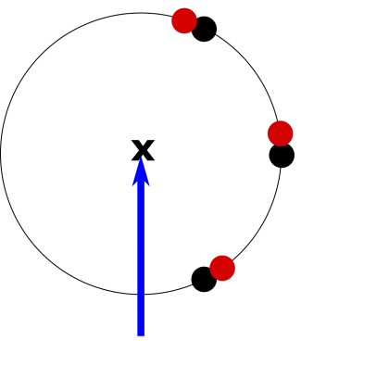
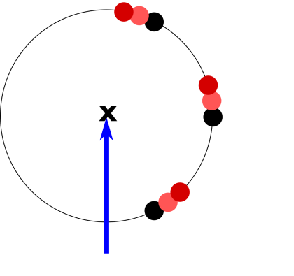
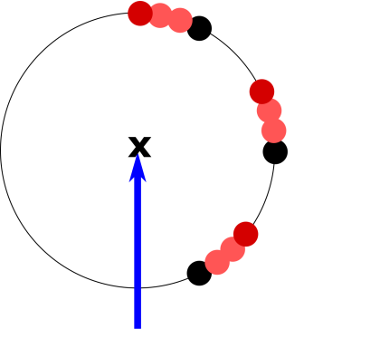
Aims for Scanning Instruments at the ILL
Support case for instruments with moving detectors only
Instruments at the ILL include D2B, D4, D7, D16 and D17
Initial work for D2B – high resolution powder diffractometer with 128 tubes x 128 pixels x 25+ steps/scan ~ 400,000 points

Slide 26
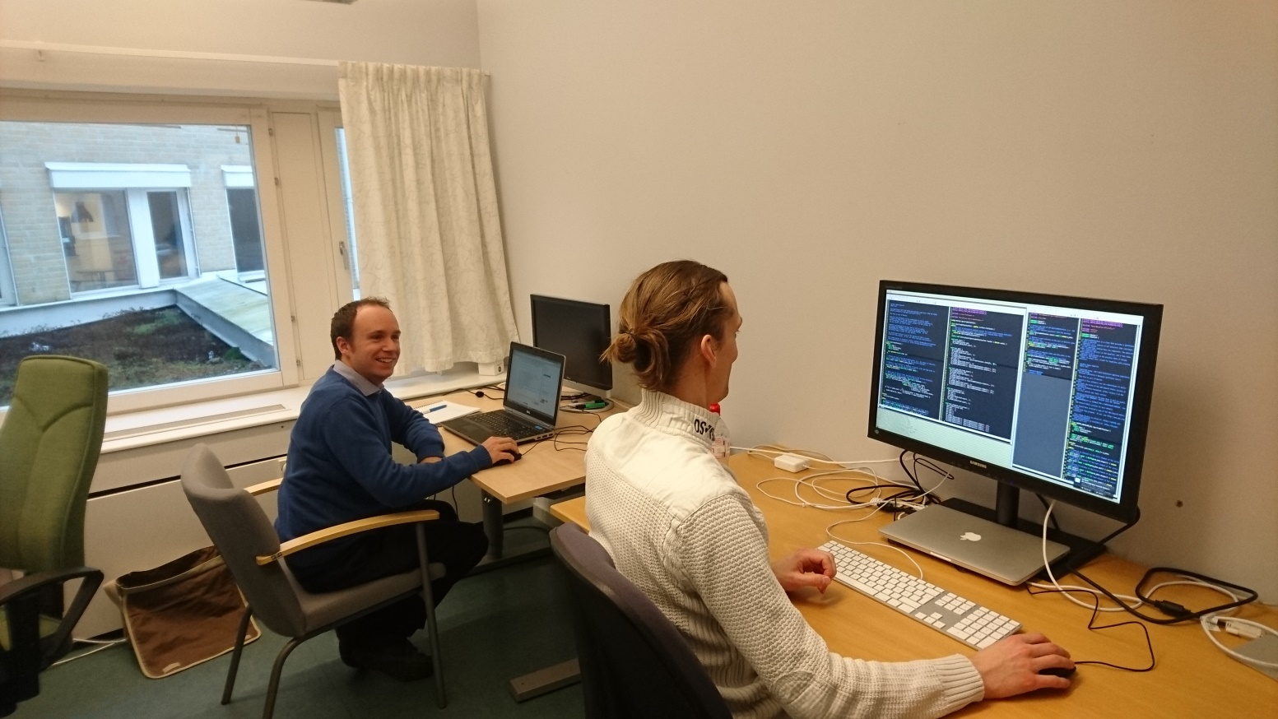
Planning and Work with the ESS
Requirement coincided with the ESS’s work on Instrument 2.0 in Mantid
ESS requirements for performance to support future instruments – addressing bottlenecks and adding MPI support
Part of the Instrument 2.0 design implemented early to also provide a long term solution for scanning instruments at the ILL
Work has been performed in close collaboration with Simon Heybrock and Owen Arnold at the ESS
https://github.com/mantidproject/documents/tree/master/Design/Instrument-2.0

Slide 27
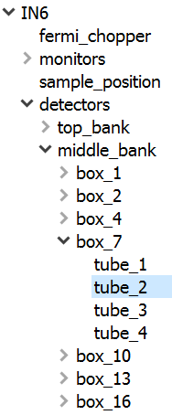
Old Position Access
Component
getPos()
0…*
Workspace
getDetector()
1
Detector
getPos()
Instrument
getPos()
1
ParameterMap
1
Contains position relative to parent for every Component
⚠ This is a highly simplified class diagram!

Slide 28
New Position Access
SpectrumInfo
position(index)
1
ParameterMap
Workspace
detectorInfo()
spectrumInfo()
DetectorInfo
position(index)
1
No longer stores position information
28
29
30
31
Indexes for each detector
Absolute position of every detector
⚠ This is a highly simplified class diagram!

Slide 29
SpectrumInfo & DetectorInfo Methods
bool isMonitor(const size_t index) const;
bool isMasked(const size_t index) const;
double l2(const size_t index) const;
double twoTheta(const size_t index) const;
double signedTwoTheta(const size_t index) const;
V3D position(const size_t index) const;
Quat rotation(const size_t index) const;
Access for non-scanning workspaces
bool isMonitor(const pair<size_t, size_t> &index) const;
bool isMasked(const pair<size_t, size_t> &index) const;
double l2(const pair<size_t, size_t> &index) const;
double twoTheta(const pair<size_t, size_t> &index) const;
double signedTwoTheta(const pair<size_t, size_t> &index) const;
V3D position(const pair<size_t, size_t> &index) const;
Quat rotation(const pair<size_t, size_t> &index) const;
Scanning access

Slide 30
Scanning Workspace Builder
Helper class for scanning workspace construction
ScanningWorkspaceBuilder(size_t nDetectors, size_t nTimeIndexes, size_t nBins);
void setInstrument(shared_ptr<const Instrument> instrument);
void setTimeRanges(const vector<pair<DateAndTime, DateAndTime>> &timeRanges);
void setTimeRanges(const DateAndTime &startTime, const vector<double> &durations);
void setPositions(vector<vector<V3D>> &positions);
void setRotations(vector<vector<Quat>> &rotations);
void setInstrumentAngles(vector<double> &instrumentAngles);
MatrixWorkspace_sptr buildWorkspace();
⚠ Work in progresss!

Slide 31
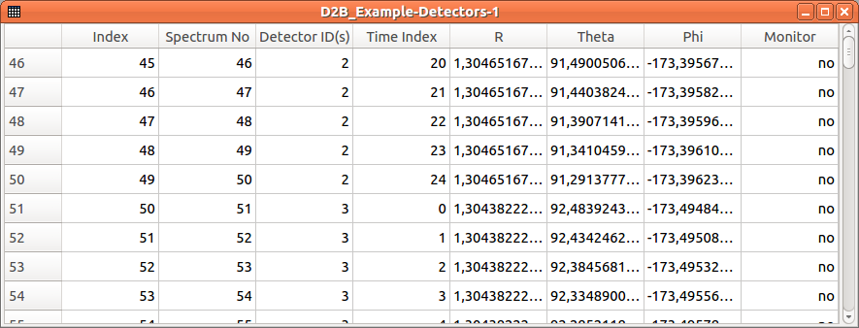
D2B Loaded Workspace
See https://github.com/mantidproject/mantid/tree/d2b_loading

Slide 32
Current Status
DetectorInfo and SpectrumInfo implemented in MantidAPI – currently these wrap the ‘real’ *Info classes and provide time indexed access
getDetector() methods for MatrixWorkspace and Instrument refactored in most of Mantid – thanks to maintenance effort
ScanningWorkspaceBuilder nearly complete
D2B loader in progress – basic construction working

Slide 33
Future Work
Saving/Loading to Mantid NeXus format – need to save and load the time indexing information
Instrument View – see instrument view for each time index or a combined view
Testing within a workflow – making algorithms that work with detectors aware of time indexing
Testing with other ILL instruments
Future work planned by ESS on Instrument 2.0 – for example ComponentInfo

Slide 34
Summary
Overview of Mantid at the ILL
Current status and future plans
Backscattering reduction (Gagik)
Time-of-flight spectroscopy (Antti)
Scanning instruments (Ian)
(Verena)

